Slide 1
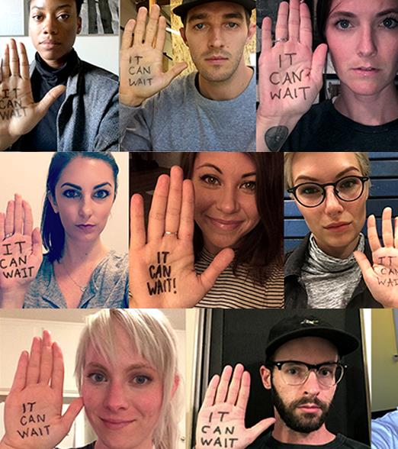


It Can Wait®
Community Presentation
INSERT YOUR LOGO HERE THEN
DELETE BOX.
ENTER YOUR TITLE HERE
ENTER THE DATE
© 2021 AT&T Intellectual Property. AT&T, Globe logo, and DIRECTV are registered trademarks and service marks of
AT&T Intellectual Property and/or AT&T affiliated companies. All other marks are the property of their respective owners

Slide 2
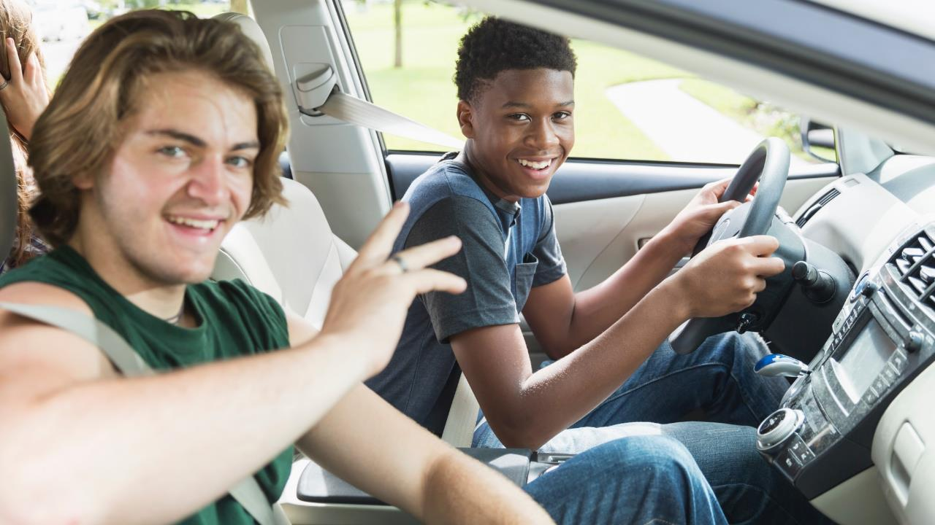

DISTRACTED
DRIVING FACTS & STATS
ICW/2021 / © 2021 AT&T Intellectual Property - AT&T Proprietary
Notes:
Today we're going to talk about distracted driving and what we can all do to help make the roads safer for everyone.​
Let's start with the facts.

Slide 3
95
%
OVER
VIEW DISTRACTED DRIVING AS A PROBLEM¹
¹ Online survey with 603 respondents (total distracted drivers n=489) conducted by Kantar Added Value. Data represented here were collected October 2019-December 2019. National panel sample (ages 15-54, drive, and have a smartphone).
Notes:
Over 95% of people know distracted driving is dangerous.¹
It’s so common that nearly a quarter of people don’t see it as a major problem¹
But it is a problem.
⁽¹⁾ Online survey with 624 respondents conducted by Added Value. Ongoing survey, data represented here were collected July 2019-September 2019. National panel sample (ages 15-54, drive, and have a smartphone).

Slide 4










Tens of thousands of people are injured — and hundreds die — every year due to smartphone distracted driving. ¹
75%
  Using GPS
  on their phone ²
68%
  Read texts, emails
  or social media ²
67%
  Choose music to play ²
60%
  Write texts, emails
  or social media posts ²
54%
  Surf the web ²
53%
  View websites ²
54%
  Watch videos/
  view pictures ²
52%
  Take pictures/
  record video ²
40%
  Use video chat apps ²
38%
  Play games ²
¹ U.S. Department of Transportation National Highway Traffic Safety Administration, Distracted Driving 2018 (Traffic Safety Facts Research Note, April 2020, Table 2 & Table 4)
² Online survey with 603 respondents (total distracted drivers n=489) conducted by Kantar Added Value. Data represented here were collected October 2019-December 2019. National panel sample (ages 15-54, drive, and have a smartphone).
ICW/2021 / © 2021 AT&T Intellectual Property - AT&T Proprietary
Notes:
Tens of thousands of people are injured — and hundreds die — every year due to smartphone distracted driving ⁽¹⁾.
Here’s a look at some of the things they are doing on their smartphones when behind the wheel ^{(2).}
People report that they text, email and view social media posts.
People report they take pictures and record video
They even surf the web and watch videos/view pictures while driving.
All of these activities are dangerous.
⁽¹⁾ U.S. Department of Transportation National Highway Traffic Safety Administration, Distracted Driving 2018 (Traffic Safety Facts Research Note, April 2020, Table 2 & Table 4)
⁽²⁾ Online survey with 624 respondents conducted by Added Value. Ongoing survey, data represented here were collected July 2019-September 2019. National panel sample (ages 15-54, drive, and have a smartphone).

Slide 5
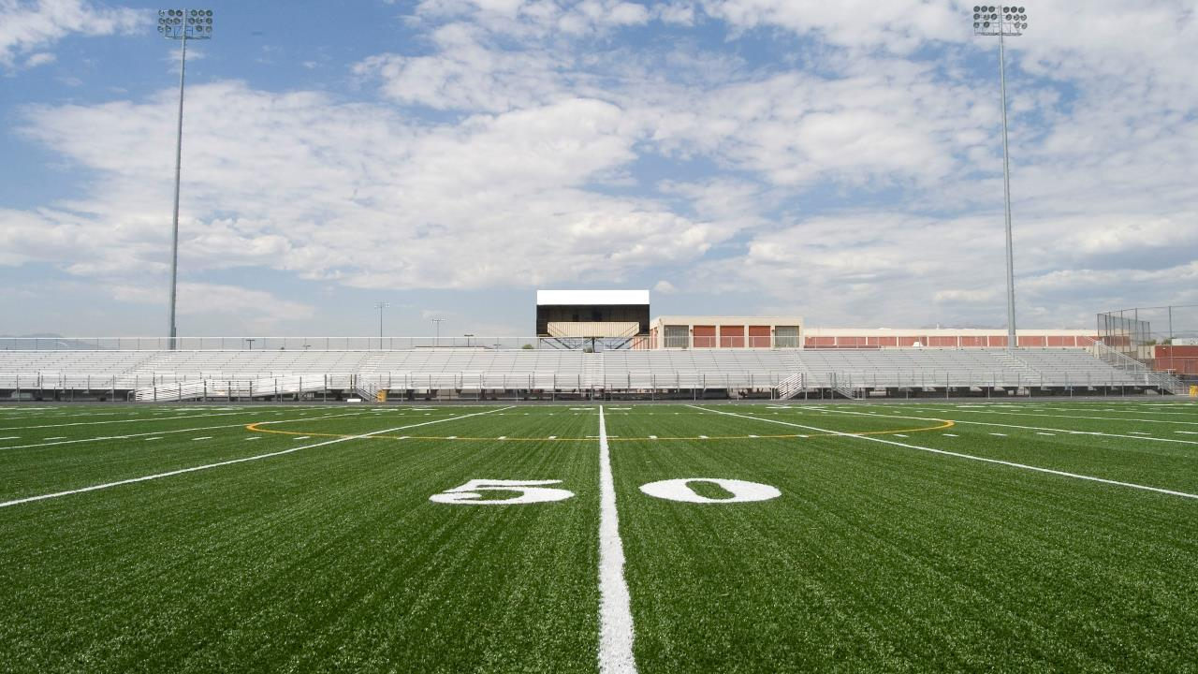
CHECKING YOUR PHONE FOR 5 SECONDS WHILE DRIVING 55MPH IS LIKE DRIVING THE LENGTH OF A FOOTBALL FIELD BLINDFOLDED
ICW/2021 / © 2021 AT&T Intellectual Property - AT&T Proprietary
Notes:
And these actions can have dangerous consequences.
Because in 5 seconds not looking at the road at 55MPH is like driving the length of a football field blindfolded.

Slide 6
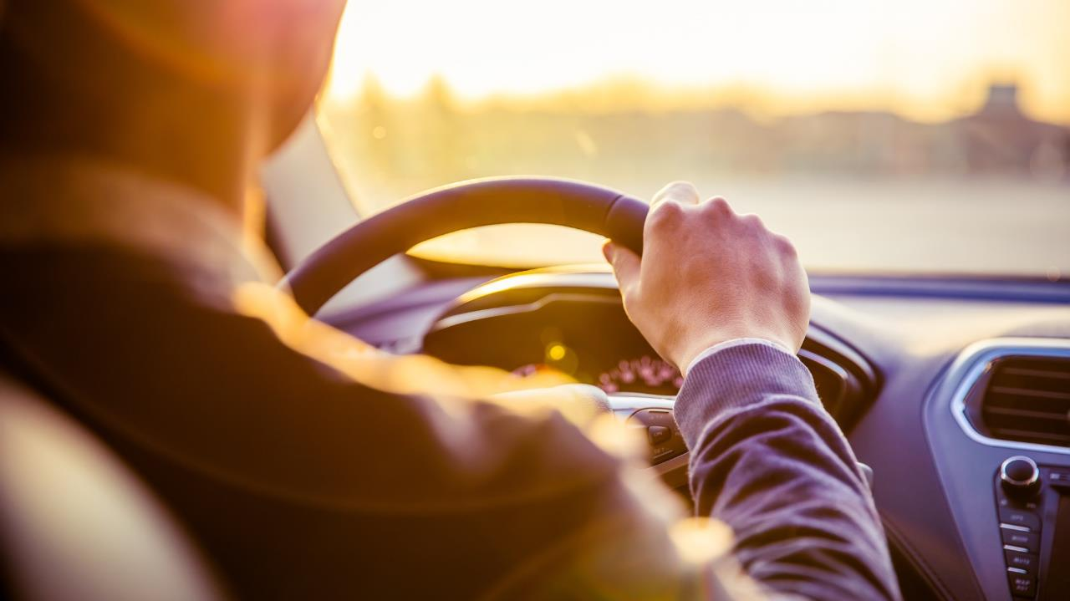
YET…
NEARLY 80%
OF PEOPLE ADMIT TO
DISTRACTED DRIVING¹
ICW/2021 / © 2021 AT&T Intellectual Property - AT&T Proprietary
¹ Online survey with 603 respondents (total distracted drivers n=489) conducted by Kantar Added Value. Data represented here were collected October 2019-December 2019. National panel sample (ages 15-54, drive, and have a smartphone).
Notes:
Yet, nearly 8-in-10 people admit they drive distracted.¹ And, more than a third of drivers call it a habit.¹
⁽¹⁾ Online survey with 624 respondents conducted by Added Value. Ongoing survey, data represented here were collected July 2019-September 2019. National panel sample (ages 15-54, drive, and have a smartphone).

Slide 7
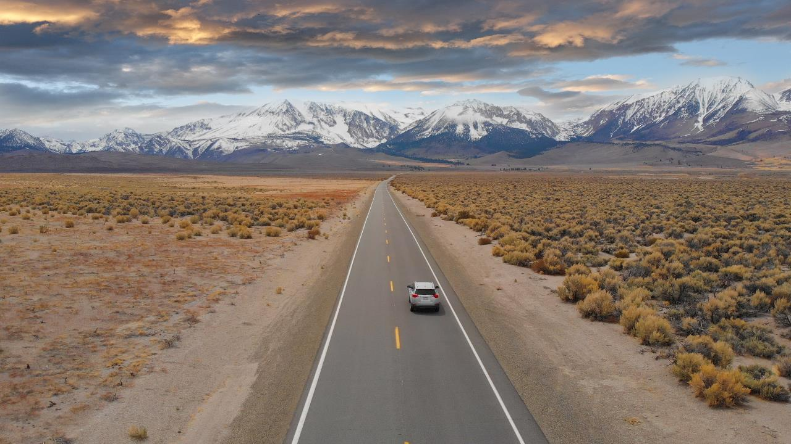
IT CAN WAIT: PLEASE DON’T DRIVE DISTRACTED.
ICW/2021 / © 2021 AT&T Intellectual Property - AT&T Proprietary
Notes:
This needs to change.
And you can help by joining the It Can Wait movement to help put an end to smartphone distracted driving.
AT&T’s It Can Wait campaign shares a simple message: Please don’t drive distracted.

Slide 8

OVER
40M
PLEDGES MADE TO DRIVE DISTRACTION FREE
ICW/2021 / © 2021 AT&T Intellectual Property - AT&T Proprietary
Notes:
Since 2010, It Can Wait has generated more than 40 million pledges to drive distraction free.

Slide 9

  48
  States have texting and driving laws.¹
  21
  States have
  hands-free laws.¹
ICW/2021 / © 2021 AT&T Intellectual Property - AT&T Proprietary
¹Governor’s Highway Safety Administration: Distracted Driving – State Laws
Notes:
Today, 48 states have implemented texting and driving laws.¹
And 21 states have hands-free driving laws.¹
(1) Governor’s Highway Safety Administration. Distracted Driving. State Laws. https://www.ghsa.org/state-laws/issues/distracted%20driving

Slide 10

BUT THE WORK IS NEVER DONE…
ICW/2021 / © 2021 AT&T Intellectual Property - AT&T Proprietary
Notes:
But the work to raise awareness about distracted driving is never done.

Slide 11
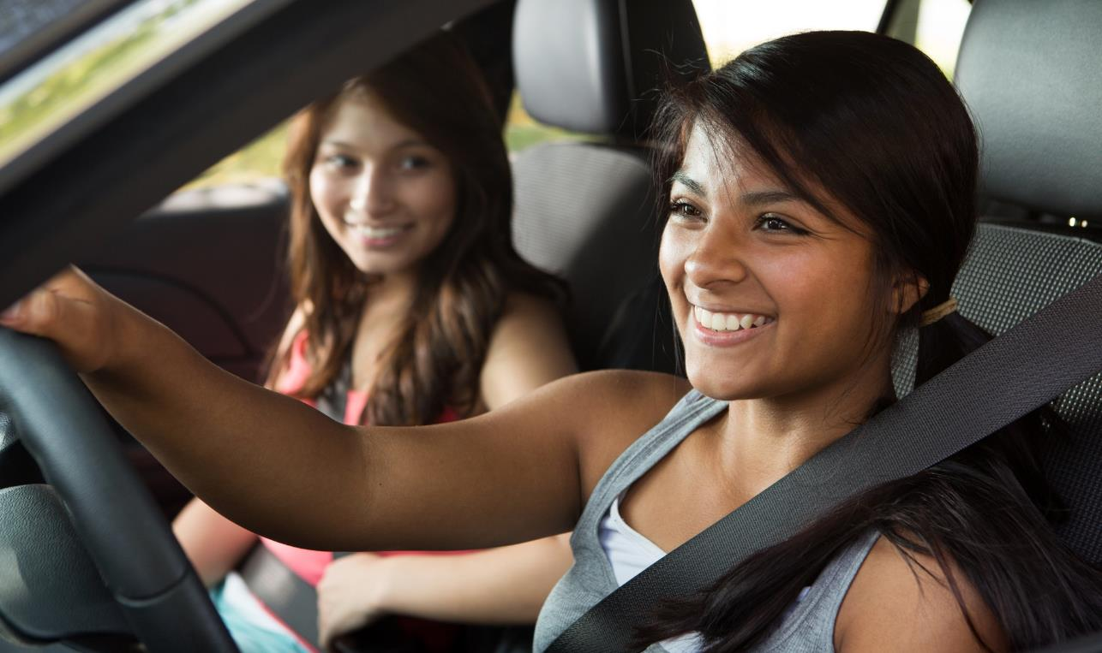


WHAT CAN
YOU DO TO
MAKE A
CHANGE?
Notes:
So what can you do to make a change?

Slide 12
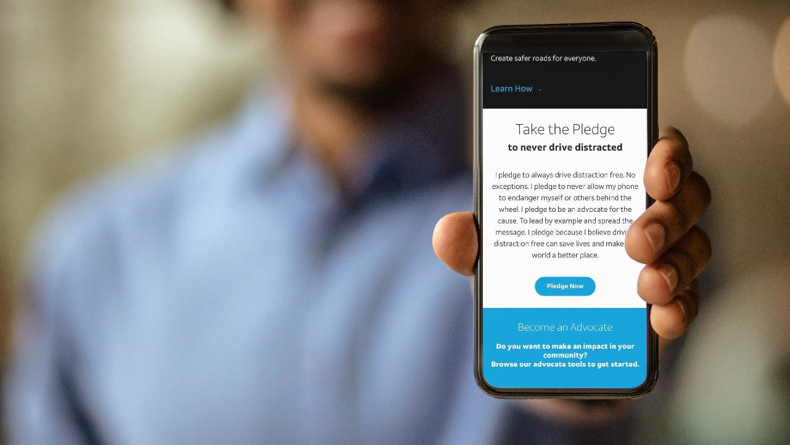
TAKE THE PLEDGE
…to never drive distracted at ItCanWait.com!
Notes:
Take the It Can Wait Pledge: “I pledge to always drive distraction free. I pledge to never allow my phone to endanger myself or others behind the wheel. I pledge to lead by example and spread the message. I pledge because I believe driving distraction free can save lives and make the world a better place.”
Activity 1: Take the pledge…like right now! Get out your phones/computers and go to It Can Wait Dot Com.
OR
Activity 2: Raise your hand if you agree to take the pledge.

Slide 13
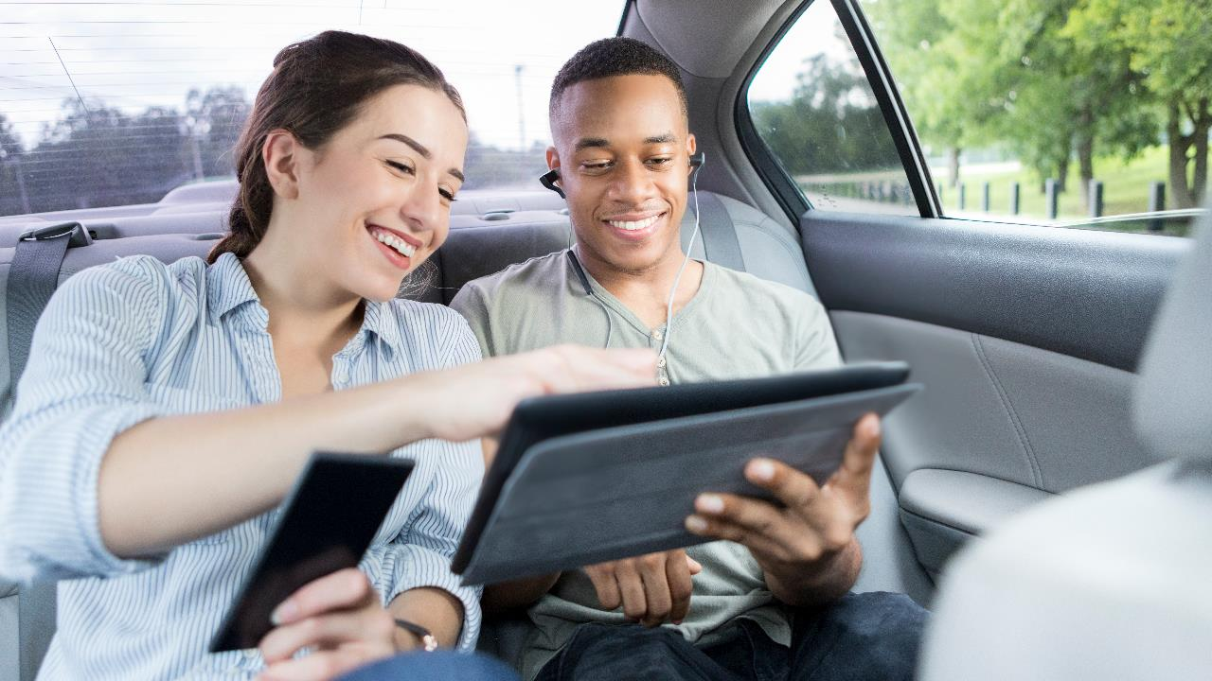
SPEAK UP
People are just waiting for someone to tell them to stop.
Notes:
57% of people are more likely to stop driving distracted if a friend or passenger pressures them to.* That means over half of people are just waiting for someone to tell them to stop. So the best way to create distraction free roads is to speak up. It’s time to feel that we have the right and the responsibility to speak up about distracted driving.
Activity on how to speak up: Show the string of videos on ItCanWait.com under Ice Breakers (links below as well) and then have them practice with someone in the audience.
You can also ask questions of the audience: Which ice breakers are you most likely to use? Do you think some would be more effective with your friends and why? What other ice breakers can you think of?
FULL SET: https://www.youtube.com/watch?v=dc1nnT4ZGDo
Be Direct https://youtu.be/OdgO8G56XT0
Offer to Help https://youtu.be/rKcENrl9dBM
Share the Facts https://youtu.be/CINrORL_XLQ
Show Some Love https://youtu.be/LrlhnIc4FNg
Take a Stand https://youtu.be/Fco4tkPp2Jo
*Online survey with 603 respondents (total distracted drivers n=489) conducted by Kantar Added Value. Data represented here were collected October 2019-December 2019. National panel sample (ages 15-54, drive, and have a smartphone)

Slide 14
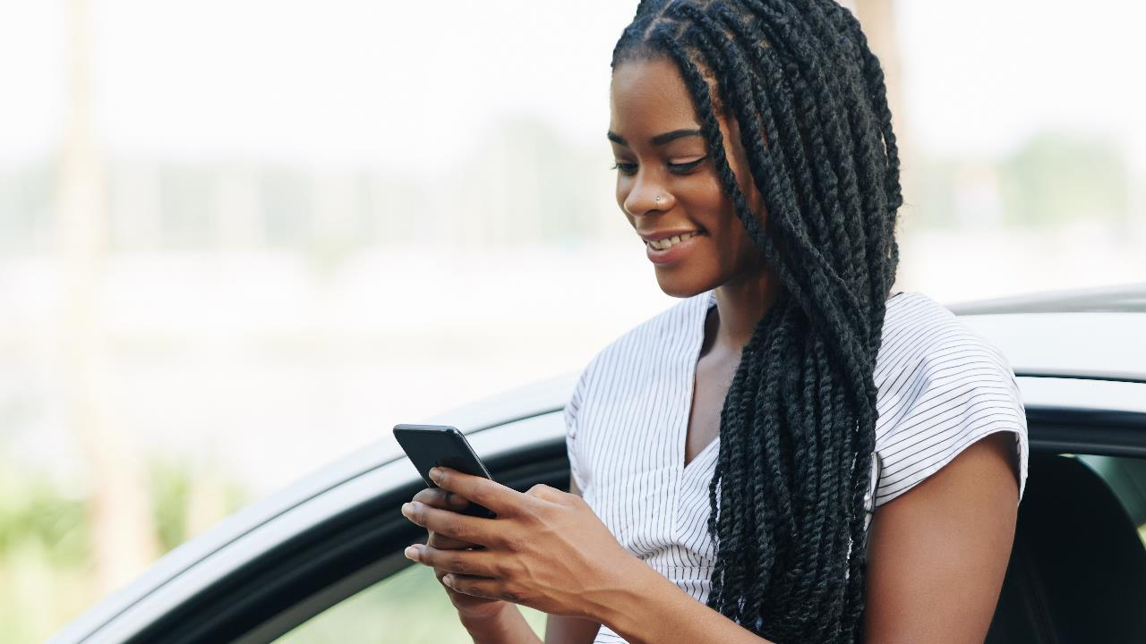
JOIN THE MOVEMENT
You can help raise awareness in your community.
Notes:
Join the movement and help make an impact. Raise awareness in your community and put an end to distracted driving.
Activity: Show the string of videos on ItCanWait.com under Tips (links below as well) and then ask questions of the audience: Which tips are you most likely to use? Do you think some would be more effective for you and why? What other tips can you think of?
FULL SET: https://www.youtube.com/watch?v=QgC6AXTOkws
If it’s that Important, Pull Over https://youtu.be/cCqzoZ24JVk
Use Your Car’s Voice Controls https://youtu.be/n78ojenK3Kc
Give Your Phone to a Passenger https://youtu.be/NIz_lcOfb8M
Keep Your Phone on Silent https://youtu.be/FB8C0XdtK2s
Use Your Phone Before You Go https://youtu.be/TURQ5An0-u4

Slide 15
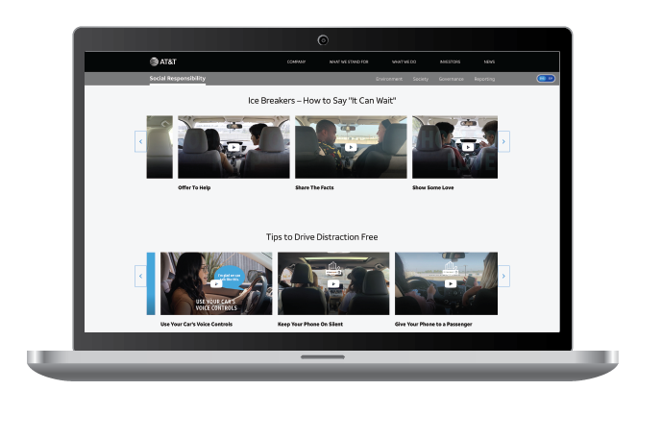
Summary: Take Action and Join the Movement
TAKE THE PLEDGE
Take the It at ItCanWait.com. Can Wait Pledge to drive distraction free
SPEAK UP
Use the Ice Breakers on ItCanWait.com to speak up and help prevent distracted driving.
JOIN THE MOVEMENT
  Find tips and other resources at ItCanWait.com to help raise awareness and put an end to distracted driving in your community.
Notes:
Take three easy steps:
Take the pledge to drive distraction free to create safer roads for everyone.
Speak up — no matter the distraction — to help reduce distracted driving.
Join the movement: On ItCanWait.com, everyone can find free resources to speak up and help prevent distracted driving. From real stories from real people impacted by distracted driving, to conversations starters with family and friends, to presentations to give in your community.

Slide 16
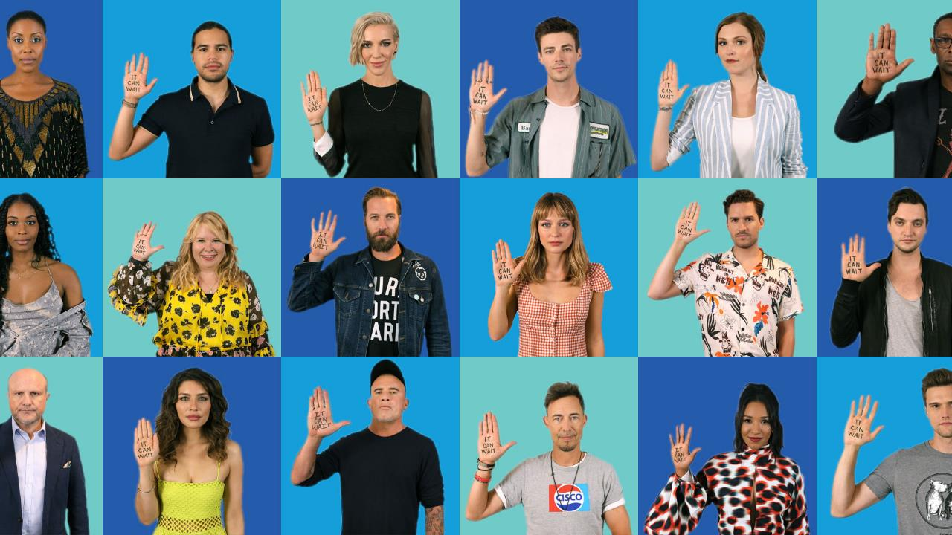
Speak up — no matter the distraction — and pledge yourself and others to never do it again.
Since 2010, It Can Wait has generated more than 40M pledges to never drive distracted. AT&T is committed to making this behavior ancient history.
Notes:
We know most people think distracted driving is wrong, dangerous, and a major problem. The only thing holding us back…is us! When you’re behind the wheel – It Can Wait!

Slide 17
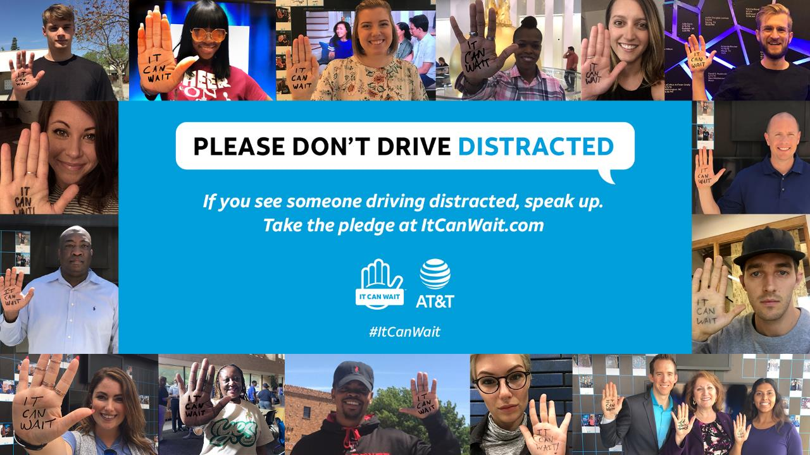

Notes:
Make a difference in your community. Join AT&T and help put an end to distracted driving. Together, we can make the roads safer for everyone.

